Slide 1
Advancement of Cognitive-Affective Map

Slide 2
CAM tools list
Data collection tool Cognitive-Affective Map Extended Logic (C.A.M.E.L.) 🐪: https://camgalaxy.github.io/
Data Analysis CAM-App programmed in Shiny (R), links to
version 1.X: not updated anymore
version 2.X: https://fennapps.shinyapps.io/CAMtools_CAMapp/
in the future an administrative webpage, current developer version: https://dashboard-vercel-8aen53m4y-fennstatistics.vercel.app/
Slack support channel: https://join.slack.com/t/cognitiveaffe-um96332/shared_invite/zt-1cybwr0tf-u2PWQh4L3BP3tuxLuH4c5w
Online documentation: https://camtools-documentation.readthedocs.io/en/master/
Manuscript
all collected CAM data sets with analysis files / explanations can be found here [future meta-analysis]: https://github.com/FennStatistics/CAMdatasets

Slide 3
Advancement of the methodology of Cognitive-Affective Mapping Developed tools, a bird's-eye view
Main article:
Fenn, J., Gouret, F., Gorki, M., Reuter, L., Gros, W., Hüttner, P., & Kiesel, A. (under review). Cognitive Affective Maps Tools: Proposing Multiple Software Solutions to Collect and Analyze Belief Systems.

Slide 4

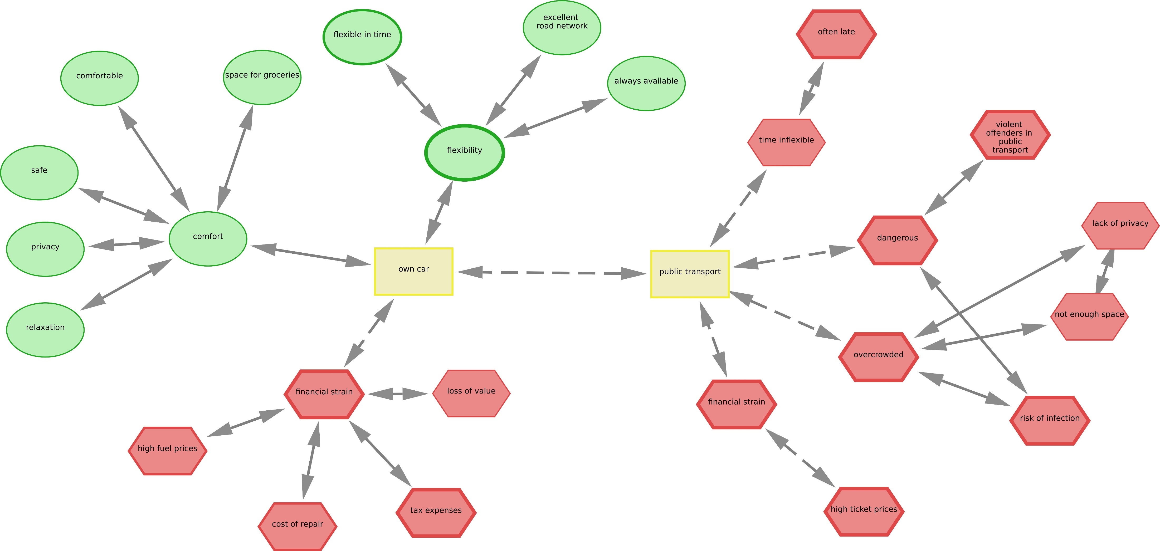
Cognitive-Affective Mapping a quantitative and qualitative research method
Florian Gouret (data engineer and software developer)
motivated by previous dissertation (Reuter, 2022)
Example: Motivation to use the own car vs. public transport (Sendtner, 2021)
Notes:
Cognitive-Affective Mapping is a quantitative and qualitative research method
resulting data Cognitive-Affective Maps (CAMs), whereby CAMs represent mental models / belief systems
Example: participants indicate their motivation to use their own car vs. public transport, wherewby "own car", "public transport" was predefined

Slide 5
Overview: CAMs - Theory
What are CAMs?
CAMs are „conceptual structures that people use to represent important aspects of the world“
„cognitive-affective map is a visual representation of the emotion values of a group of interconnected concepts“
this is how CAMs differ from semantic networks, because CAMs additionally contain emotions (valence)
hot cognition: emotions cannot be separated from cognitions
How are CAMs constructed?
the stepwise construction process of CAMs can be understood as a multiple constraint satisfaction process, where concepts, conditions, goals, etc. are mentally represented with the involvement of emotions
Concepts in the CAM are only changed or added if they correspond to the „most coherent account of what we want to understand“
Thagard (2000); Thagard (2006); Thagard (2021)

Slide 6
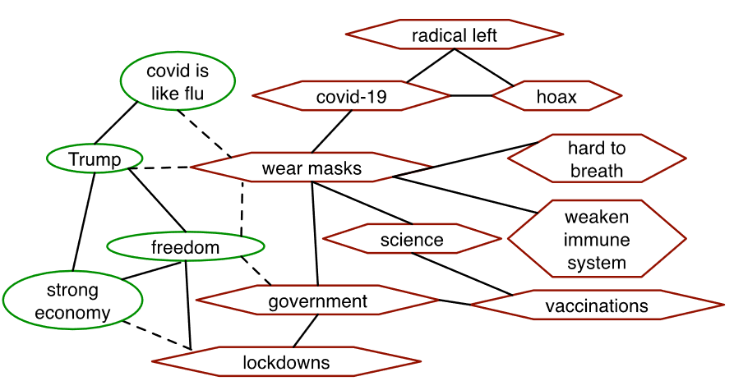
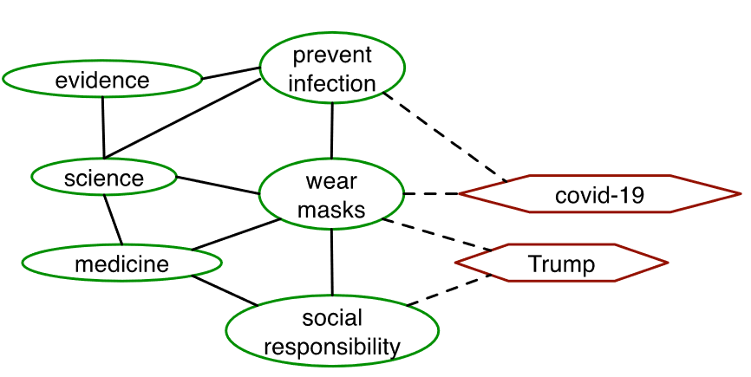
Overview: CAMs - Theory
multiple constraint satisfaction process, where concepts, conditions, goals, etc. are mentally represented with the involvement of emotions
Concepts in the CAM are only changed or added if they correspond to the „most coherent account of what we want to understand“
Thagard (2021)

Slide 7
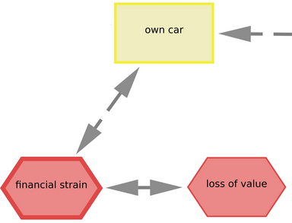
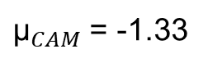
Advancement of Cognitive-Affective Mapping a quantitative and qualitative research method
Semantic content
Network parameters
${\text{μ}}_{CAM}$ = -1.33
Qualitative
Quantitative
Quantification of semantic content, of valence ratings and of network parameters
Network topology
Enables statistical analyses / significance tests
Expression of individual / group perspectives
Little suggestive influence by researchers’ presuppositions
Contextualization
Mixed Methods
(Estadieu* et al., in prep.; Fenn et al., under review; Fenn, Gorki, et al., in prep.; Fenn, Sölder, et al., in prep.; Fenn et al., 2023; Gros et al., submitted manuscript; Höfele et al., 2022; Livanec et al., 2022; Luthardt et al., 2020, 2022; Mansell, Mock, et al., 2021; Mansell, Reuter, et al., 2021; Reuter et al., 2021, 2022)

Slide 8
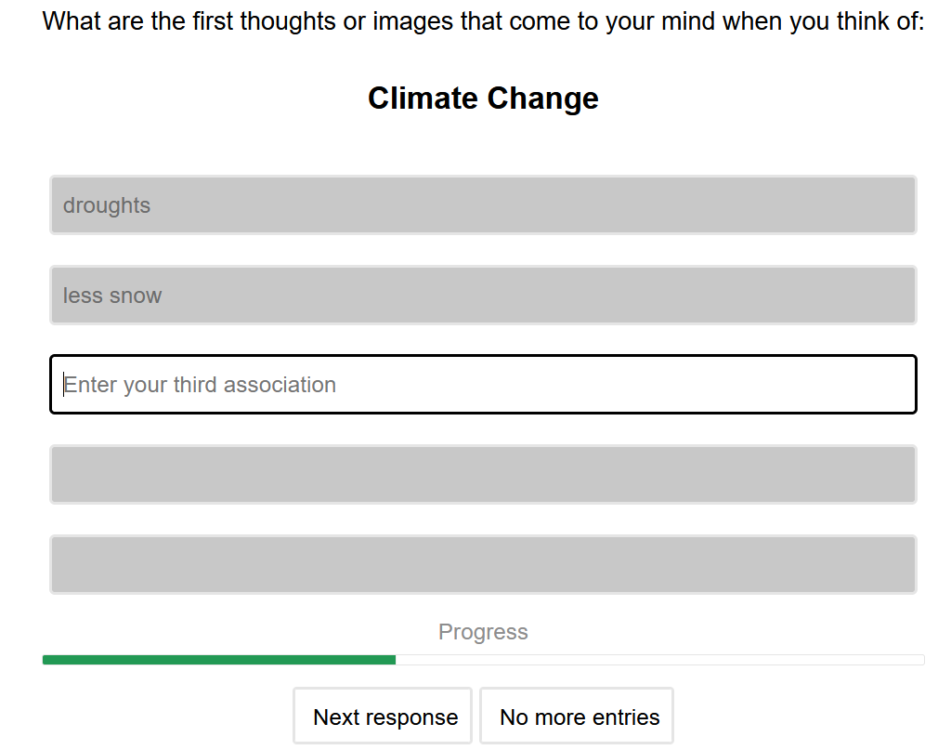
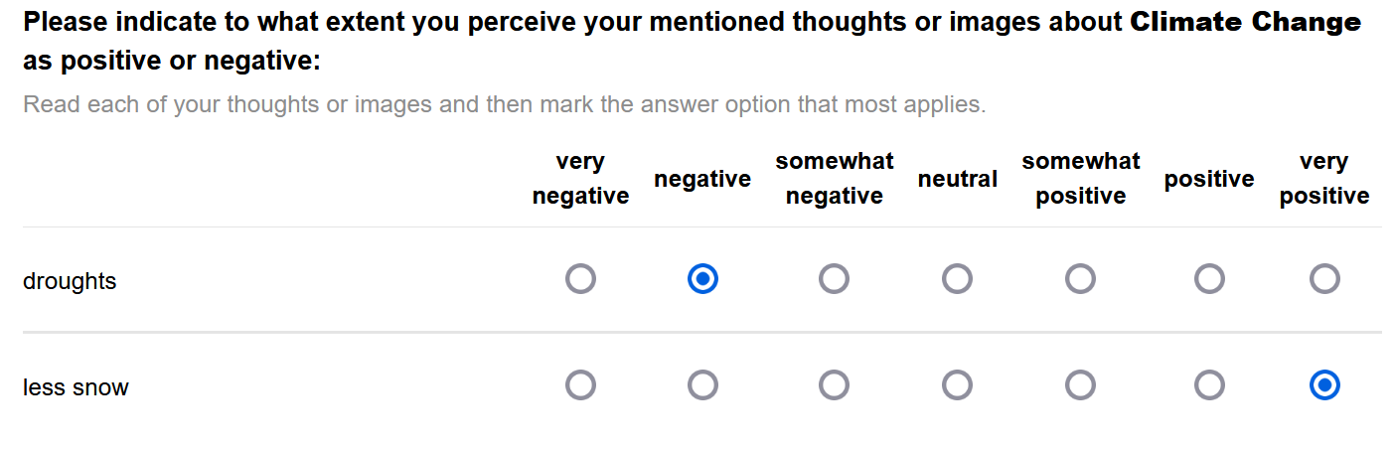
Cognitive-Affective Maps Dimensionality of Data?
Affective Imagery Technique, Word Association Game
measures free associations (perceptual representations such as images, sounds, words) of people to a specific object
Affective images contain two elements:
cognitive component (the triggered image or thought)
affective component (positive or negative evaluation)
Supervising Bachelor thesis: “Comparative analysis of Cognitive Affective Mapping and the Affective Imagery Technique for the assessment of belief systems: An empirical investigation”
(e.g., Leiserowitz, 2006)

Slide 9
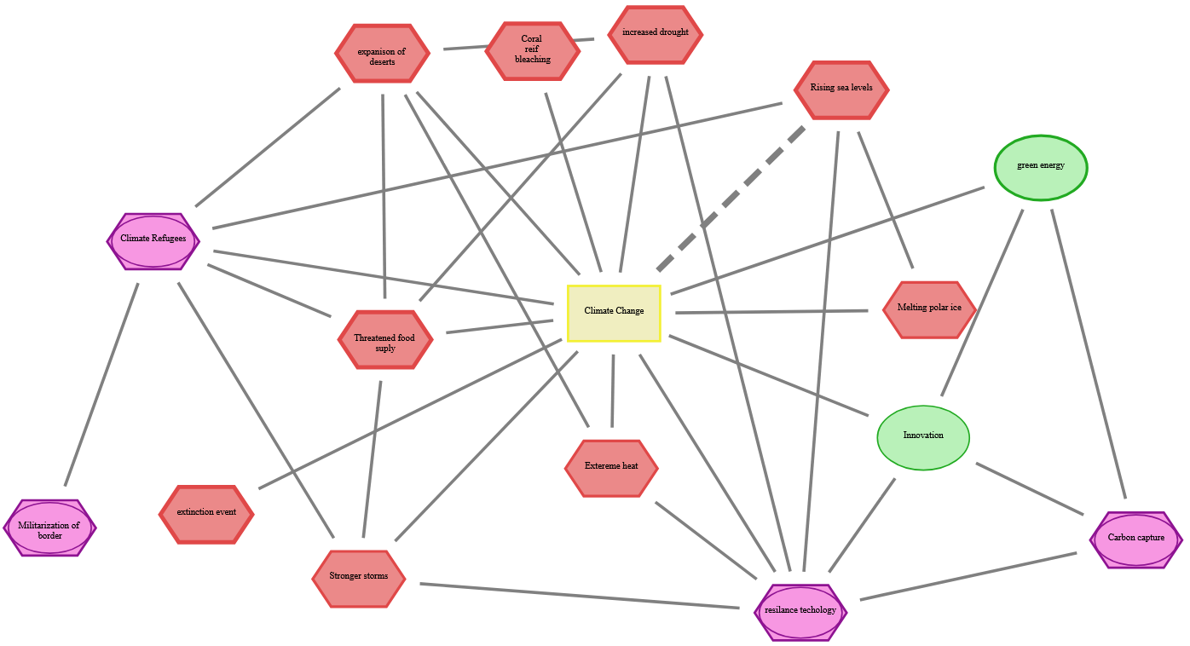
Cognitive-Affective Maps Dimensionality of Data?

Slide 10
Overview: CAMs - Fields of Application
to study if CAMs are supplementary to questionnaires - Mansell et al. (2021); Mansell et al. (2021)
agent-based modelling - e.g. Wolf et al. (2015); Schröder et al. (2017)
use CAMs for conflict mediation - e.g. Gros et al. (2021)
evaluate via CAMs the success of an intervention - e.g. Reuter et al. (2021); Luthardt et al. (2020)
use CAMs as a pre-study to entrich subsequent survey studies - e.g. Fenn et al. (2023)
…
see two sections of CAM tools online documentation: “Additional Resources”; “What are the advantages of using Cognitive-Affective Maps?” in https://osf.io/q5hj4/
Thagard (2000); Thagard (2006); Thagard (2021)

Slide 11
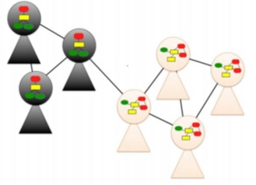
Cognitive-Affective Mapping Fundamental Hypothesis
Hypothesis: The generation process of CAMs is not arbitrary, but is determined by multiple processes at multiple levels, and thus CAMs from similar individuals on an identical topic exhibit systematic correlations (similar data generating process)
can be presented by a „emergent product of interaction between networks of mental representations at the individual level and networks of social communication at the group level“
Homer-Dixon, T., Maynard, J. L., Mildenberger, M., Milkoreit, M., Mock, S. J., Quilley, S., Schröder, T., & Thagard, P. (2013). A Complex Systems Approach to the Study of Ideology: Cognitive-Affective Structures and the Dynamics of Belief Systems. Journal of Social and Political Psychology, 1(1), Article 1. https://doi.org/10.5964/jspp.v1i1.36; Figure 1
if stochasticity is ubiquitous in complex networks, these networks are not maximally random either; rather, they obey organization principles that make them functional
(Bianconi, 2018)

Slide 12
DGP: Stochastic Process > see “CAMtools Workshop 20231128”
Bianconi (2018); Homer-Dixon et al. (2013)

Slide 13
Literature related to CAMs
Mental models are internal representations of the world that individuals create to interpret, understand, and interact with their environment. These models are shaped by personal experiences, knowledge, and beliefs, and they guide how people perceive situations, make decisions, and solve problems. Mental models are dynamic and can evolve with new information and experiences.
Semantic networks are a type of knowledge representation in cognitive science, artificial intelligence, and computer science. These networks are used to model the relational structure of knowledge, showing how different concepts are interconnected. Semantic networks can be used for information retrieval, understanding language, and in artificial intelligence for tasks like reasoning and decision-making.
Fuzzy Cognitive Map is a cognitive model that represents the causal reasoning and decision-making processes of individuals or systems. Causal relationships between concepts are depicted as weighted, directed edges. The weights (degrees of influence) can have positive or negative values, indicating the type and strength of the influence one concept has on another.
Thagard (2000); Thagard (2006); Thagard (2021)

Slide 14
Current Work Publication List I - Empirical Articles
Höfele, P., Reuter, L., Estadieu, L., Livanec, S., Stumpf, M., & Kiesel, A. (2022). Connecting the methods of psychology and philosophy: Applying Cognitive-Affective Maps (CAMs) to identify ethical principles underlying the evaluation of bioinspired technologies. Philosophical Psychology, 0(0), 1–24. https://doi.org/10.1080/09515089.2022.2113770
Luthardt, J., Morgan, J. H., Bormann, I., & Schröder, T. (2022). Quantifying emotionally grounded discursive knowledge with cognitive-affective maps. Quality & Quantity, 56(3), 1557–1595. https://doi.org/10.1007/s11135-021-01195-7
Luthardt, J., Schröder, T., Hildebrandt, F., & Bormann, I. (2020). “And Then We’ll Just Check If It Suits Us” – Cognitive-Affective Maps of Social Innovation in Early Childhood Education. Frontiers in Education, 5, 1–19. https://doi.org/10.3389/feduc.2020.00033
Mansell, J., Mock, S., Rhea, C., Tecza, A., & Piereder, J. (2021). Measuring attitudes as a complex system: Structured thinking and support for the Canadian carbon tax. Politics and the Life Sciences, 40(2), 179–201. https://doi.org/10.1017/pls.2021.16
Mansell, J., Reuter, L., Rhea, C., & Kiesel, A. (2021). A Novel Network Approach to Capture Cognition and Affect: COVID-19 Experiences in Canada and Germany. Frontiers in Psychology, 12, 1–14. https://doi.org/10.3389/fpsyg.2021.663627
Reuter, L., Fenn, J., Bilo, T. A., Schulz, M., Weyland, A. L., Kiesel, A., & Thomaschke, R. (2021). Leisure walks modulate the cognitive and affective representation of the corona pandemic: Employing Cognitive-Affective Maps within a randomized experimental design. Applied Psychology: Health and Well-Being, 13(4), 952–967. https://doi.org/10.1111/aphw.12283
Fenn, J., Helm, J., Höfele, P., Kulbe, L., Ernst, A., & Kiesel, A. (2023). Identifying Key-Psychological Factors Influencing the Acceptance of yet Emerging Technologies – A Multi-Method-Approach to Inform Climate Policy.
Thagard (2000); Thagard (2006); Thagard (2021)

Slide 15
Current Work Publication List II - Bachelor, Master Theses I
Bilo, T., & Helm, J. (2021). A Further Step Towards Sustainable Development – Re-evaluating and Expanding Cognitive-Affective Mapping for Technology Acceptance Prediction. https://www.psychologie.uni-freiburg.de/abteilungen/Allgemeine.Psychologie/research/cam-research/bachelorthesis_bilo-helm_2021_english.pdf
Dörr, M. (2020). Eine Qualitative Analyse von Kognitiv-Affektiven Karten: Können Daten von Kognitiv-Affektiven Karten im Vergleich zu Fragebögen zusätzliche Informationen geben? https://www.psychologie.uni-freiburg.de/abteilungen/Allgemeine.Psychologie/research/cam-research/masterthesis_doerr_2021_german.pdf
Gros, W., Reuter, L., Stumpf, M., & Kiesel, A. (2021). CAMediaid: Multimethod approach to assess Cognitive-Affective Maps in mediation - A quantitative validation study. https://doi.org/10.13140/RG.2.2.12436.78726
Koloczek, N. (2020). Förderung der Benutzerfreundlichkeit für die Methode „Cognitive-Affective-Mapping“. https://www.psychologie.uni-freiburg.de/abteilungen/Allgemeine.Psychologie/research/cam-research/masterthesis_koloczek_2020_german.pdf
Kreil, A. (2018). Cognitive-Affective Mapping within the context of staircase and elevator use. Evaluating a new method in empirical psychological research [Master’s Thesis]. Albert-Ludwigs-Universität Freiburg i. Br. Lewis, A. J. (2020). The Public Acceptability of Perovskite Solar Photovoltaics in the Context of the German Energy Transition.
Reuter, L. (2019). Collection and evaluation of basal attributes of living materials systems [University of Freiburg]. https://doi.org/10.13140/RG.2.2.27832.90889
Thagard (2000); Thagard (2006); Thagard (2021)

Slide 16
Current Work Publication List II - Bachelor, Master Theses II
Ricken, D. (2020). A Step towards Sustainable Development: Predicting the Acceptance of life-like Materials Systems with Cognitive-Affective Mapping. https://www.psychologie.uni-freiburg.de/abteilungen/Allgemeine.Psychologie/research/cam-research/masterthesis_ricken_2020_english.pdf
Rothmann, W. (2022). Cognitive-Affective Maps—Verständnis für Konzeptzusammenhänge in Abhängigkeit der Valenzen. https://www.psychologie.uni-freiburg.de/abteilungen/Allgemeine.Psychologie/research/cam-research/rothmann2022.pdf
Sendtner, C. (2021). Kostbare Kisten: Gründe für Fehleinschätzungen der Kosten des eigenen Autos und deren Auswirkungen auf die Bewertung des ÖPNV -Masterarbeit [University of Freiburg]. https://doi.org/10.13140/RG.2.2.32640.56325
Thagard (2000); Thagard (2006); Thagard (2021)

Slide 17
Current Work Publication List III - Conceptual Articles
Homer-Dixon, T., Maynard, J. L., Mildenberger, M., Milkoreit, M., Mock, S. J., Quilley, S., Schröder, T., & Thagard, P. (2013). A Complex Systems Approach to the Study of Ideology: Cognitive-Affective Structures and the Dynamics of Belief Systems. Journal of Social and Political Psychology, 1(1), Article 1. https://doi.org/10.5964/jspp.v1i1.36
Homer-Dixon, T., Milkoreit, M., Mock, S. J., Schröder, T., & Thagard, P. (2014). The Conceptual Structure of Social Disputes: Cognitive-Affective Maps as a Tool for Conflict Analysis and Resolution. SAGE Open, 4(1), 1–20. https://doi.org/10.1177/2158244014526210
Livanec, S., Stumpf, M., Reuter, L., Fenn, J., & Kiesel, A. (2022). Who’s gonna use this? Acceptance prediction of emerging technologies with Cognitive-Affective Mapping and transdisciplinary considerations in the Anthropocene. The Anthropocene Review, 1–20. https://doi.org/10.1177/20530196221078924
Reuter, L., Mansell, J., Rhea, C., & Kiesel, A. (2022). Direct assessment of individual connotation and experience: An introduction to cognitive-affective mapping. Politics and the Life Sciences, 41(1), 131–139. https://doi.org/10.1017/pls.2021.31
Thagard, P. (2000). Coherence in Thought and Action. MIT Press.
Thagard, P. (2006). Hot Thought: Mechanisms and Applications of Emotional Cognition. MIT Press.
Thagard, P. (2021). The cognitive science of COVID-19: Acceptance, denial, and belief change. Methods, 195, 92–102. https://doi.org/10.1016/j.ymeth.2021.03.009
Thagard (2000); Thagard (2006); Thagard (2021)

Slide 18
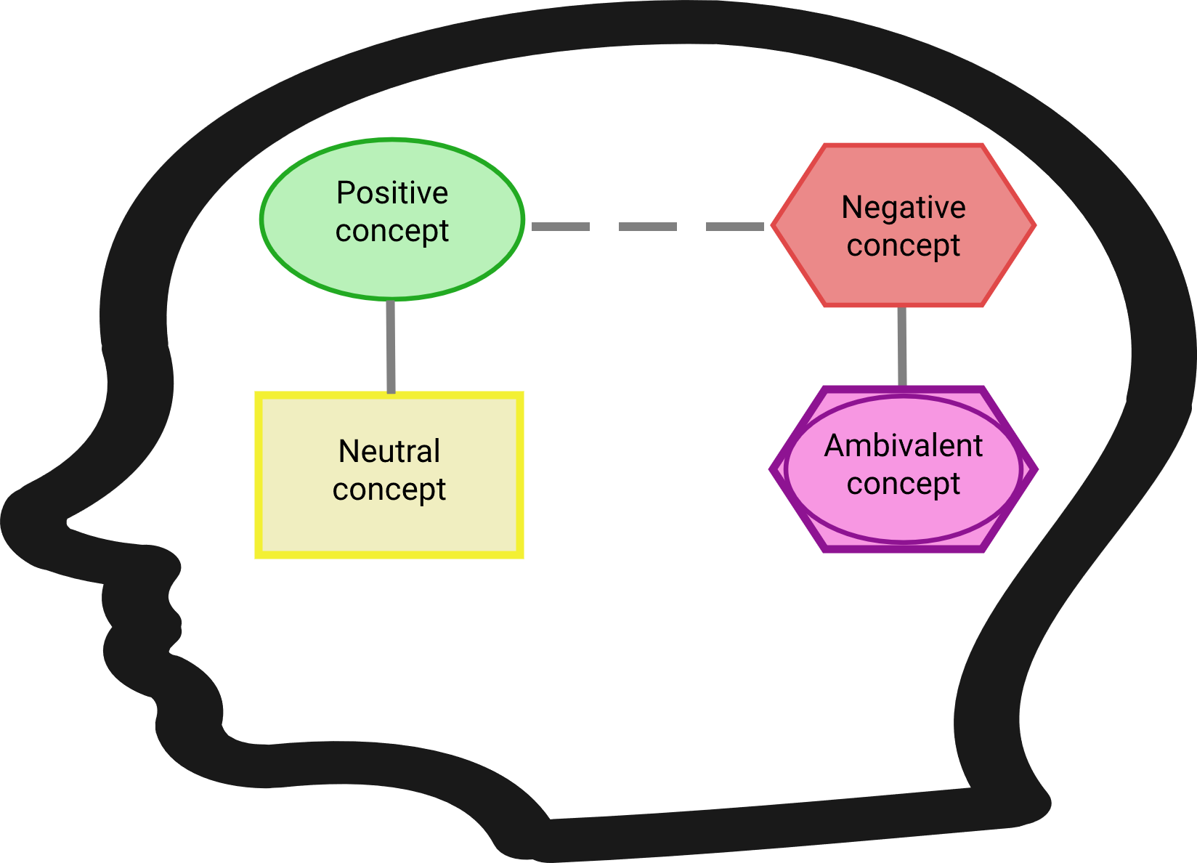
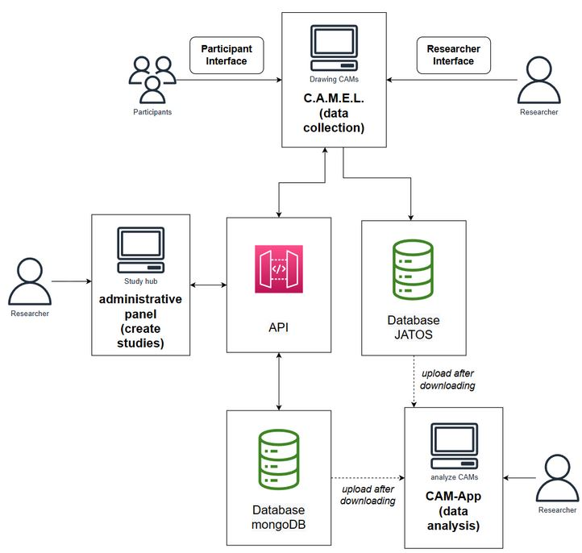
Developed Tools
Central web page: https://drawyourminds.de
General information on the developed tools; possible to set-up CAM studies without the need for programming
Central web page: https://osf.io/q5hj4/
Detailed documentation of developed CAM tools and explanations for how to set up studies with multiple examples; thematically sorted CAM literature
Slack Channel: http://tinyurl.com/bdeka4kx
Support channel for setting up CAM studies and most recent updates; invitation
CAM-App: https://fennapps.shinyapps.io/CAMtools_CAMapp/
CAM-App deployed on Shiny server to analyze resulting CAM data
GitHub: https://github.com/Camel-app
All the code of the programmed CAM tools

Slide 19
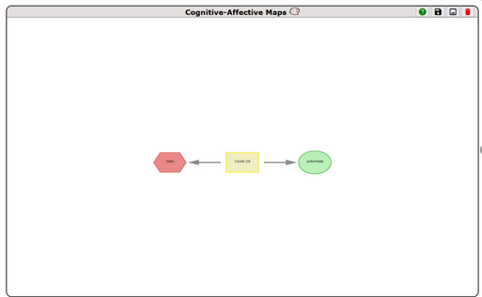
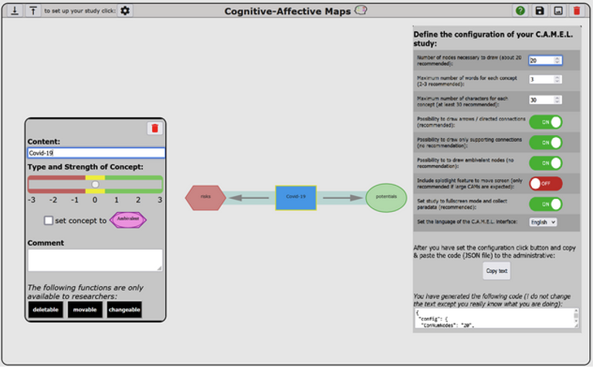
Data Collection Cognitive-Affective Map Extended Logic (C.A.M.E.L.)
an easy and intuitive interface to draw Cognitive-Affective Maps (CAMs) for participants and researchers
drawn CAMs are saved on the client-side as Java Script classes, which respects the classical data model of networks
Participant view:
Researcher view:

Slide 20
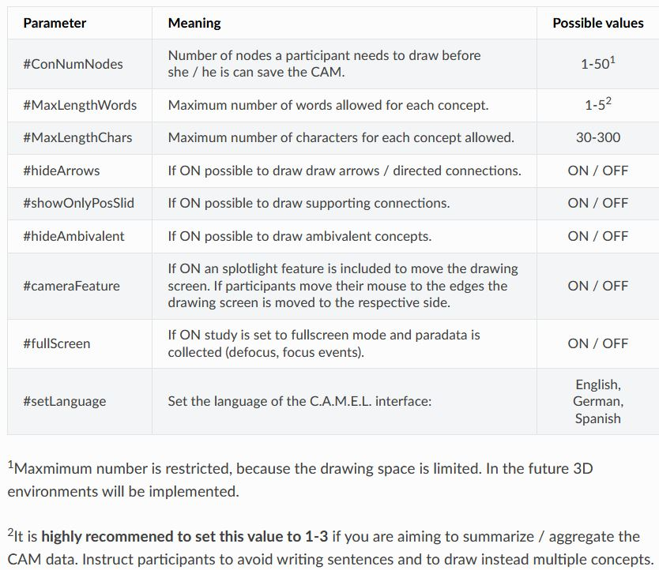
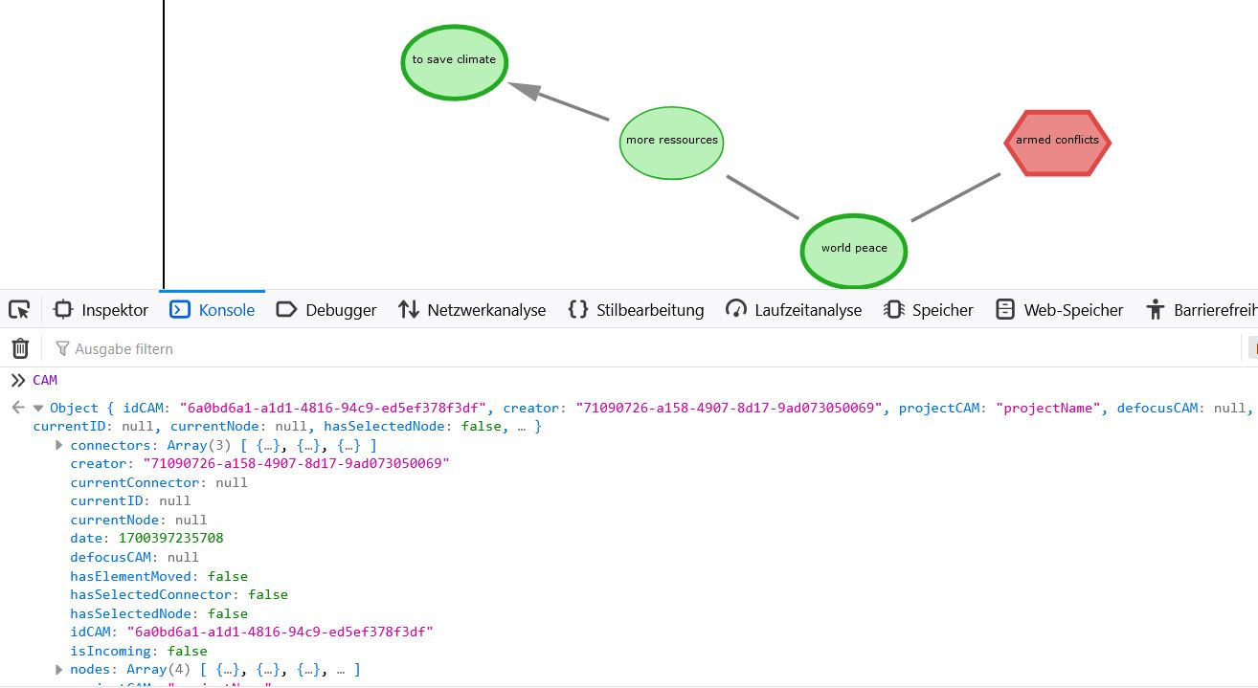
Data Collection - highly adaptable Cognitive-Affective Map Extended Logic (C.A.M.E.L.)
Possible configurations of C.A.M.E.L.:
Data model of CAMs allows to run adaptive study designs, e.g., using Java Script library Cytoscape
Fenn, J., Sölder, P., Königs, L., Reuter, L., Conrad, S., Estadieu, L., Höfele, P., & Kiesel, A. (in prep.). Using Basal Attributes to Identify Key Properties of New Material Systems to Increase the Acceptance.
Estadieu*, L., Fenn*, J., Gorki, M., Monno, I., Tauber, F., Teichmann, J., Levy-Tzedek, S., Müller, O., & Kiesel, A. (in prep.). Societal Assessment of Soft Robots: Identifying Key Risks and Benefits of Soft Robots Compared to Conventional Robots.
Kulbe, L., Fenn, J., Sendtner, C., Reuter, L., Stumpf, M., & Kiesel, A. (in prep.). Connecting Instrumental and Affective Motives of Transportation Modality Choice—Realistic Cost Assessment Influences Affective Evaluation of Private Car.

Slide 21


Data Analysis CAM-App
Pre-processing:
summarizing concepts under superordinate categories; modules for training raters and computing inter-rater reliability coefficients
protocol is automatically generated in the background capturing each data pre-processing and analysis step
From Wickham, H., & Grolemund, G. (2017). R for Data Science: Import, Tidy, Transform, Visualize, and Model Data. O’Reilly Media, Inc. https://r4ds.had.co.nz/; Chapter 1 Introduction
Analysis step:
analyze CAM data; multiple modules for semantic content (e.g., aggregate CAMs) and network parameters (e.g., slice CAMs)
Notes:
Protocol – transparency central quality indicators of qualitative research

Slide 22
Data Analysis - Modules CAM-App
functionalities are based on over 31 R functions, Python code divided in 28 modules (modularly programmed)
Preprocessing Part
Analysis Part
Import/Upload data
Draw CAMs
Approximate matching
Searching terms
Search for synonyms
Apply word2vec model
Overview of non-summarized concepts
Compute inter-rater reliability
Train raters for summarizing of concepts
Import/Upload data
Draw CAMs
Compute network indicators
Compute neighborhood indicators
Compute descriptive statistics on network indicators
Create wordlist
Create word cloud
Get table, pie chart
Get summary statistics
Aggregate CAMs
Concept co-occurrences
Valence co-occurrences
Similarity Algorithms
Slice CAMs
Get summary statistics
Get Report

Slide 23
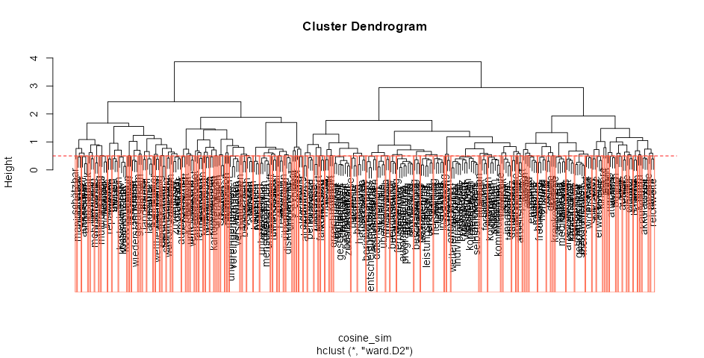
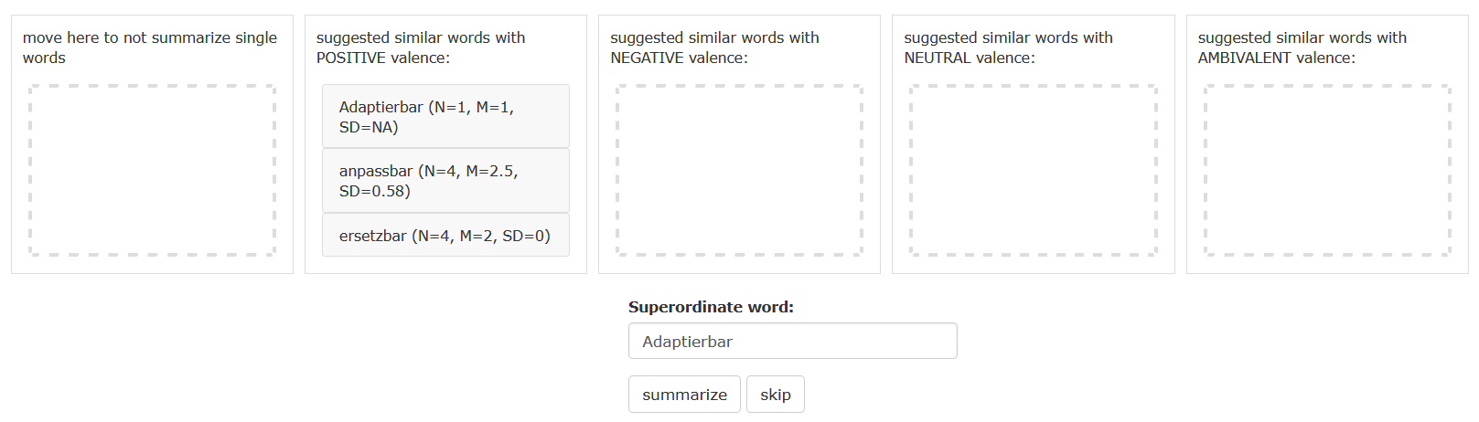
Data Analysis - pre-processing Apply Large Language Model
applying a word2vec Model it is possible to compute the cosine similarity between drawn concepts pairwise to identify groups of drawn concepts with similar meaning
cosine similarity between the words “responsibility” and “accountability” would be .70
valence-sensitive summary process

Slide 24
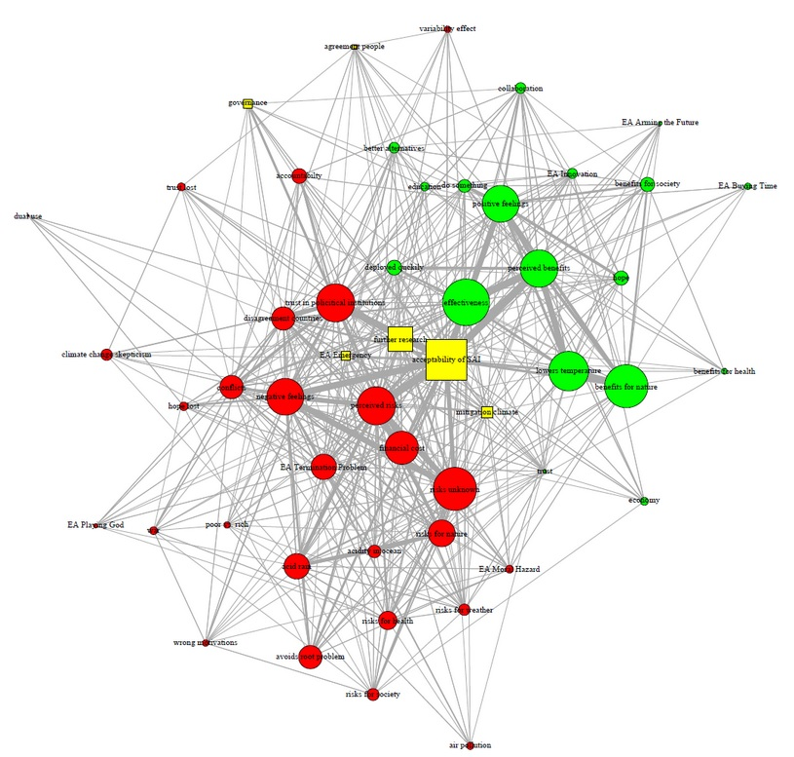
Data Analysis - analysis step Aggregate CAMs
to highlight the inter-relatedness of all summarized terms, the CAMs can be aggregated by creating a so-called “canonical adjacency matrix”
example of 58 summarized CAMs:
concept is drawn as neutral if the average valence of the respective concept is within [-.5, .5]

Slide 25
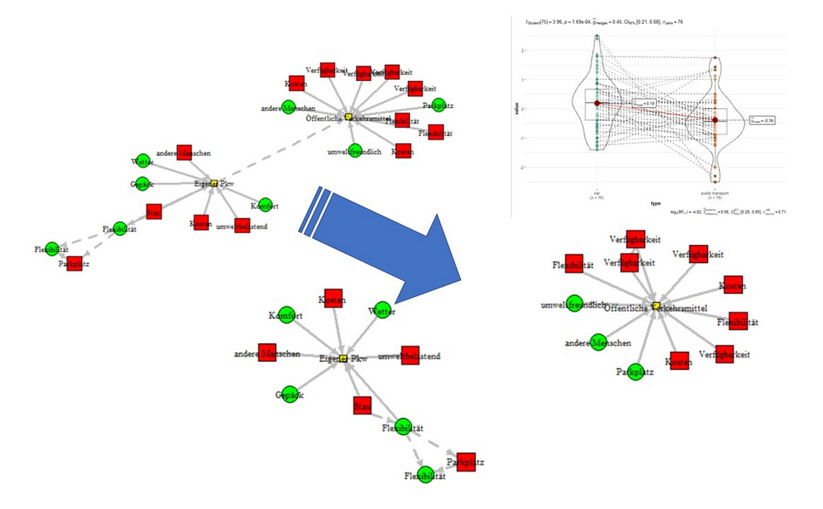
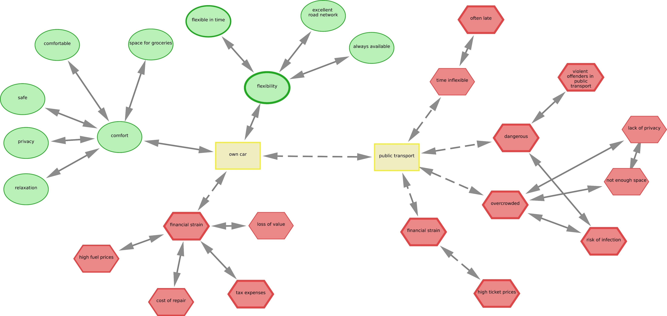
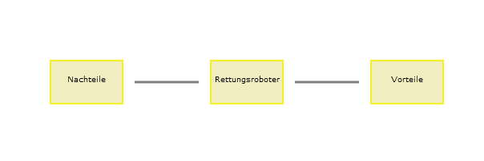
Data Analysis - analysis step Slice CAMs
CAMs can be automatically sliced according to two possible criteria: (a) delete a connection between two concepts, (b) delete a concept
example previously shown CAM:
Estadieu*, L., Fenn*, J., Gorki , M., Monno, I., Tauber, F., Teichmann, J., Levy-Tzedek, S., Müller, O., & Kiesel, A. (in prep.). Societal Assessment of Soft Robots: Identifying Key Risks and Benefits of Soft Robots Compared to Conventional Robots.

Slide 26
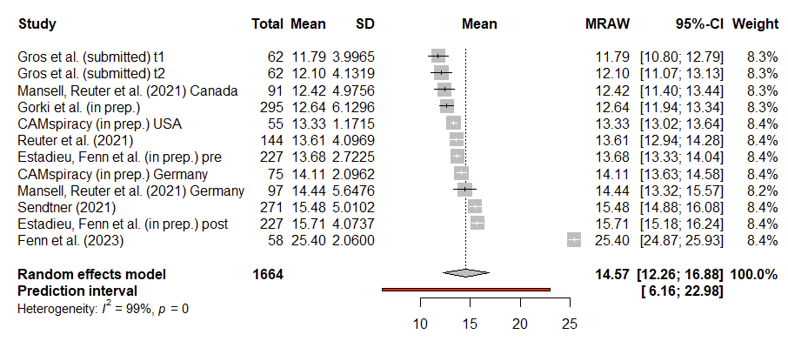
Meta-Analytical Perspective Number of drawn concepts
estimated average mean based on the random-effects model was μ = 14.57 (95% CI: 12.51 to 16.63)
without Fenn et al. (2023) μ = 13.61 (95% CI: 12.74 to 14.48)

Slide 27














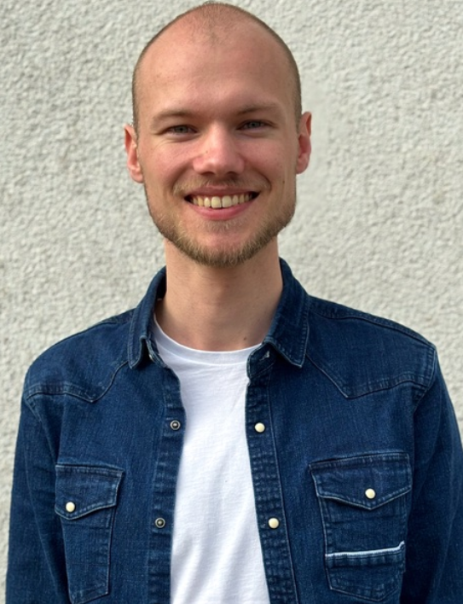









Who is currently using the developed CAM tools?
Dr. Louisa Estadieu (Postdoc, Philosophy)
Dr. Philipp Höfele (Philosophy)
Prof. Dr. Andrea Kiesel
Prof. Dr. Ulf Hahnel
Dr. Estefania Gazzo (Psychology)
Paul Sölder (Student, Psychology)
Dr. Lisa Reuter (Psychology)
Prof. Dr. Rui Mata
Christophe Becht (Student, Psychology)
More to come:
Lars Kulbe (Student, Psychology)
Nina Frings (PhD, Psychology)
Michael Gorki (PhD, Psychology)
Wilhelm Gros (PhD, Psychology)
Dara Kamalian (Student, Informatics)
Sabrina Livanec (PhD, Psychology)
Dr. Irina Monno (Psychology)
Moritz Pischel (PhD in SMiP, Psychology)

Slide 28
References
Bianconi, G. (2018). Multilayer Networks: Structure and Function. Oxford University Press.
Böschen, S., Grunwald, A., Krings, B.-J., & Rösch, C. (2021). Technikfolgenabschätzung: Handbuch für Wissenschaft und Praxis. Nomos Verlag.
Collingridge, D. (1980). Social Control of Technology. Milton Keynes: Open University Press.
Crutzen, P. J. (2002). Geology of mankind. Nature, 415(6867), Article 6867. https://doi.org/10.1038/415023a
Crutzen, P. J., & Stoermer, E. F. (2000). The ‘Anthropocene.’ IGBP’s Global Change Newsletter, 17–18.
Davies, S. R., Macnaghten, M., & Kearnes, M. (2009). Reconfiguring responsibility: Deepening debate on nanotechnology: A research report from the DEEPEN Project [Project Report]. Durham University. http://dro.dur.ac.uk/6399/
Davies, S. R., & Macnaghten, P. (2010). Narratives of Mastery and Resistance: Lay Ethics of Nanotechnology. NanoEthics, 4(2), 141–151. https://doi.org/10.1007/s11569-010-0096-5
Düwell, M. (2009). Wofür braucht die Medizinethik empirische Methoden? Ethik in der Medizin, 21(3), 201–211. https://doi.org/10.1007/s00481-009-0019-6
Fenn, J., Helm, J. F., Höfele, P., Kulbe, L., Ernst, A., & Kiesel, A. (2023). Identifying key-psychological factors influencing the acceptance of yet emerging technologies–A multi-method-approach to inform climate policy. PLOS Climate, 2(6), 1–25. https://doi.org/10.1371/journal.pclm.0000207
Grunwald, A. (1999). Technology assessment or ethics of technology? Ethical Perspectives, 6(2), 170–182. https://doi.org/10.2143/EP.6.2.505355
Grunwald, A. (2022). Technikfolgenabschätzung: Einführung. Nomos Verlag.
Grunwald, A., & Hillerbrand, R. (2021). Handbuch Technikethik. J. B. Metzler. https://link.springer.com/book/10.1007/978-3-476-04901-8
Gros, W. J., Reuter, L. S., Sprich, J., Schuldzinski, D., Fenn, J., & Kiesel, A. (submitted manuscript). Cognitive-Affective Maps (CAMs) as Measurement Tool – Elaboration of Quantitative and Qualitative Test-Retest Reliability.
Guston, D. H., & Sarewitz, D. (2002). Real-time technology assessment. Technology in Society, 24(1), 93–109. https://doi.org/10.1016/S0160-791X(01)00047-1
Homer-Dixon, T., Maynard, J. L., Mildenberger, M., Milkoreit, M., Mock, S. J., Quilley, S., Schröder, T., & Thagard, P. (2013). A Complex Systems Approach to the Study of Ideology: Cognitive-Affective Structures and the Dynamics of Belief Systems. Journal of Social and Political Psychology, 1(1), Article 1. https://doi.org/10.5964/jspp.v1i1.36
Höfele, P., Reuter, L., Estadieu, L., Livanec, S., Stumpf, M., & Kiesel, A. (2022). Connecting the methods of psychology and philosophy: Applying Cognitive-Affective Maps (CAMs) to identify ethical principles underlying the evaluation of bioinspired technologies. Philosophical Psychology, 0(0), 1–24. https://doi.org/10.1080/09515089.2022.2113770
Jacobs, J. (2002). Dimensions of Moral Theory: An Introduction to Metaethics and Moral Psychology. Blackwell Publishers.
Kosow, H., & Gassner, R. (2008). Methods of Future and Scenario Analysis: Overview, Assessment, and Selection Criteria (Vol. 39). Deutsches Institut für Entwicklungspolitik gGmbH. https://www.ssoar.info/ssoar/handle/document/19366
Leiserowitz, A. A. (2006). Climate Change Risk Perception and Policy Preferences: The Role of Affect, Imagery, and Values. Climatic Change, 77(1), 45–72. https://doi.org/10.1007/s10584-006-9059-9
Lewis, S. L., & Maslin, M. A. (2015). Defining the Anthropocene. Nature, 519(7542), Article 7542. https://doi.org/10.1038/nature14258
Livanec, S., Stumpf, M., Reuter, L., Fenn, J., & Kiesel, A. (2022). Who’s gonna use this? Acceptance prediction of emerging technologies with Cognitive-Affective Mapping and transdisciplinary considerations in the Anthropocene. The Anthropocene Review, 1–20. https://doi.org/10.1177/20530196221078924
Lucke, D. (1995). Akzeptanz: Legitimität in der „Abstimmungsgesellschaft“. Springer-Verlag.
Luthardt, J., Morgan, J. H., Bormann, I., & Schröder, T. (2022). Quantifying emotionally grounded discursive knowledge with cognitive-affective maps. Quality & Quantity, 56(3), 1557–1595. https://doi.org/10.1007/s11135-021-01195-7
Luthardt, J., Schröder, T., Hildebrandt, F., & Bormann, I. (2020). “And Then We’ll Just Check If It Suits Us” – Cognitive-Affective Maps of Social Innovation in Early Childhood Education. Frontiers in Education, 5, 1–19. https://doi.org/10.3389/feduc.2020.00033
Mansell, J., Mock, S., Rhea, C., Tecza, A., & Piereder, J. (2021). Measuring attitudes as a complex system: Structured thinking and support for the Canadian carbon tax. Politics and the Life Sciences, 40(2), 179–201. https://doi.org/10.1017/pls.2021.16
Mansell, J., Reuter, L., Rhea, C., & Kiesel, A. (2021). A Novel Network Approach to Capture Cognition and Affect: COVID-19 Experiences in Canada and Germany. Frontiers in Psychology, 12, 1–14. https://doi.org/10.3389/fpsyg.2021.663627
Markus, M. L., & Mentzer, K. (2014). Foresight for a responsible future with ICT. Information Systems Frontiers, 16(3), 353–368. https://doi.org/10.1007/s10796-013-9479-9
Marshall, K. P. (1999). Has Technology Introduced New Ethical Problems? Journal of Business Ethics, 19(1), 81–90. https://doi.org/10.1023/A:1006154023743
Molewijk, B., Stiggelbout, A. M., Otten, W., Dupuis, H. M., & Kievit, J. (2004). Scientific Contribution. Empirical data and moral theory. A plea for integrated empirical ethics. Medicine, Health Care and Philosophy, 7(1), 55–69. https://doi.org/10.1023/B:MHEP.0000021848.75590.b0
Möller, M., & Grießhammer, R. (2022). Prospective technology assessment in the Anthropocene: A transition toward a culture of sustainability. The Anthropocene Review, 9(2), 257–275. https://doi.org/10.1177/20530196221095700
Paulo, N., & Bublitz, J. C. (2020). Empirische Ethik: Grundlagentexte aus Psychologie und Philosophie. Suhrkamp Verlag.
Persson, L., Carney Almroth, B. M., Collins, C. D., Cornell, S., de Wit, C. A., Diamond, M. L., Fantke, P., Hassellöv, M., MacLeod, M., Ryberg, M. W., Søgaard Jørgensen, P., Villarrubia-Gómez, P., Wang, Z., & Hauschild, M. Z. (2022). Outside the Safe Operating Space of the Planetary Boundary for Novel Entities. Environmental Science & Technology, 56(3), 1510–1521. https://doi.org/10.1021/acs.est.1c04158
Pieper, A. (2017). Einführung in die Ethik. UTB.
Reijers, W., Wright, D., Brey, P., Weber, K., Rodrigues, R., O’Sullivan, D., & Gordijn, B. (2018). Methods for Practising Ethics in Research and Innovation: A Literature Review, Critical Analysis and Recommendations. Science and Engineering Ethics, 24(5), 1437–1481. https://doi.org/10.1007/s11948-017-9961-8
Reuter, L., Fenn, J., Bilo, T. A., Schulz, M., Weyland, A. L., Kiesel, A., & Thomaschke, R. (2021). Leisure walks modulate the cognitive and affective representation of the corona pandemic: Employing Cognitive-Affective Maps within a randomized experimental design. Applied Psychology: Health and Well-Being, 13(4), 952–967. https://doi.org/10.1111/aphw.12283
Reuter, L., Mansell, J., Rhea, C., & Kiesel, A. (2022). Direct assessment of individual connotation and experience: An introduction to cognitive-affective mapping. Politics and the Life Sciences, 41(1), 131–139. https://doi.org/10.1017/pls.2021.31
Reuter, L. (2022). Bridging Over the Troubled Waters of Quantitative and Qualitative Methods: Exploring Cognitive-Affective Maps in Empirical Research [PhD Thesis, University of Freiburg, Germany]. https://www.psychologie.uni-freiburg.de/Members/lreuter/Reuterdiss
Reynolds, S. J. (2006). A neurocognitive model of the ethical decision-making process: Implications for study and practice. Journal of Applied Psychology, 91(4), 737–748. https://doi.org/10.1037/0021-9010.91.4.737
Rockström, J., Steffen, W., Noone, K., Persson, Å., Chapin, F. S., Lambin, E. F., Lenton, T. M., Scheffer, M., Folke, C., Schellnhuber, H. J., Nykvist, B., de Wit, C. A., Hughes, T., van der Leeuw, S., Rodhe, H., Sörlin, S., Snyder, P. K., Costanza, R., Svedin, U., … Foley, J. A. (2009). A safe operating space for humanity. Nature, 461(7263), Article 7263. https://doi.org/10.1038/461472a
Schwartz, M. S. (2016). Ethical Decision-Making Theory: An Integrated Approach. Journal of Business Ethics, 139(4), 755–776. https://doi.org/10.1007/s10551-015-2886-8
Sendtner, C. (2021). Kostbare Kisten: Gründe für Fehleinschätzungen der Kosten des eigenen Autos und deren Auswirkungen auf die Bewertung des ÖPNV -Masterarbeit [University of Freiburg]. https://doi.org/10.13140/RG.2.2.32640.56325
Sollie, P., & Düwell, M. (2009). Evaluating New Technologies: Methodological Problems for the Ethical Assessment of Technology Developments. Springer Science & Business Media.
Steffen, W., Broadgate, W., Deutsch, L., Gaffney, O., & Ludwig, C. (2015). The trajectory of the Anthropocene: The great acceleration. The Anthropocene Review, 2(1), 81–98. https://doi.org/10.1177/2053019614564785 Article information Article has an altmetric score of 849 Full Access
Sterner, T., Barbier, E. B., Bateman, I., van den Bijgaart, I., Crépin, A.-S., Edenhofer, O., Fischer, C., Habla, W., Hassler, J., Johansson-Stenman, O., Lange, A., Polasky, S., Rockström, J., Smith, H. G., Steffen, W., Wagner, G., Wilen, J. E., Alpízar, F., Azar, C., … Robinson, A. (2019). Policy design for the Anthropocene. Nature Sustainability, 2(1), Article 1. https://doi.org/10.1038/s41893-018-0194-x
Straub, J. (2015). In search of technology readiness level (TRL) 10. Aerospace Science and Technology, 46, 312–320. https://doi.org/10.1016/j.ast.2015.07.007
Tran, T. A., & Daim, T. (2008). A taxonomic review of methods and tools applied in technology assessment. Technological Forecasting and Social Change, 75(9), 1396–1405. https://doi.org/10.1016/j.techfore.2008.04.004
Upham, P., Oltra, C., & Boso, À. (2015). Towards a cross-paradigmatic framework of the social acceptance of energy systems. Energy Research & Social Science, 8, 100–112. https://doi.org/10.1016/j.erss.2015.05.003
Wickham, H., & Grolemund, G. (2017). R for Data Science: Import, Tidy, Transform, Visualize, and Model Data. O’Reilly Media, Inc. https://r4ds.had.co.nz/
Wright, D. (2011). A framework for the ethical impact assessment of information technology. Ethics and Information Technology, 13(3), 199–226. https://doi.org/10.1007/s10676-010-9242-6

Slide 29
Appendix
Notes:
The necessity of an multi-method approach;
First short definition of empirical ethics

Slide 30
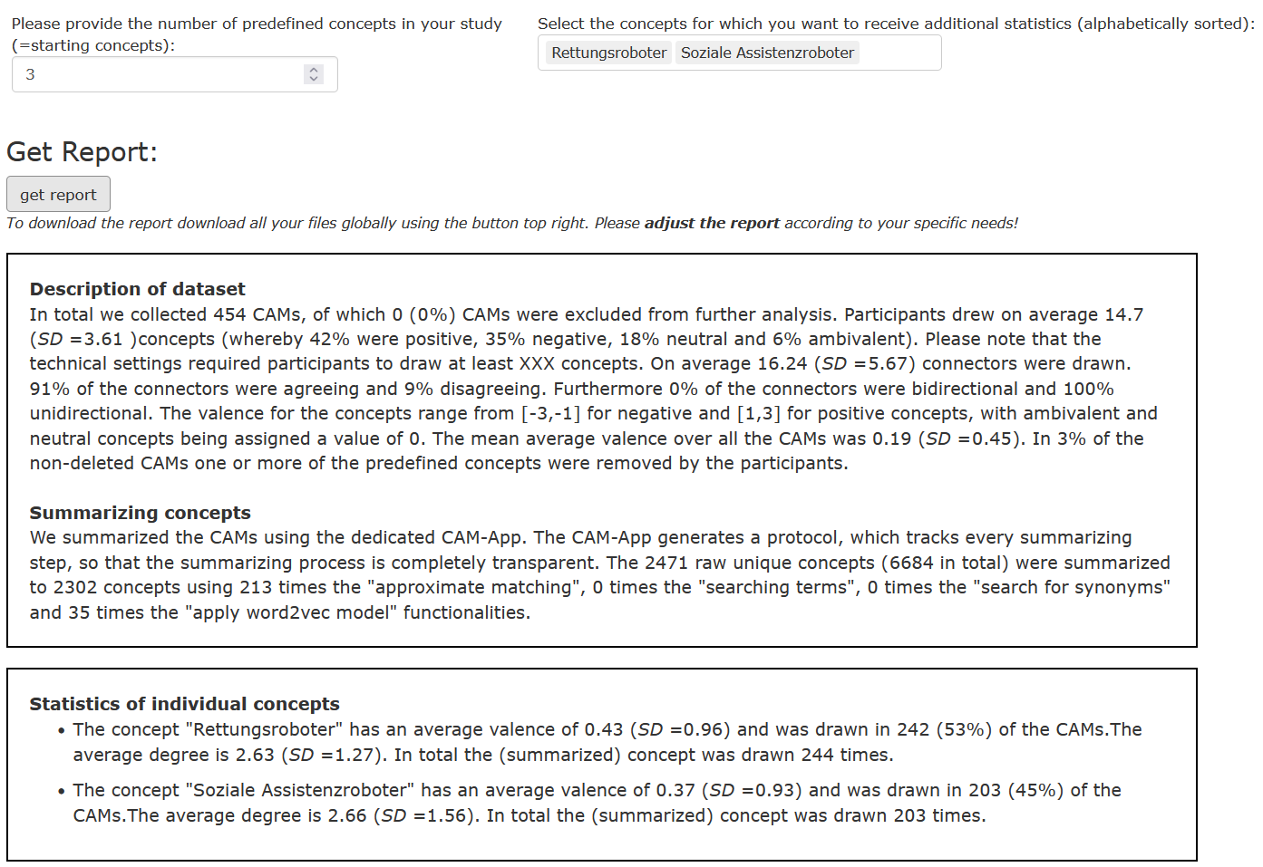
CAM-App - protocol
Estadieu*, L., Fenn*, J., Gorki, M., Monno, I., Tauber, F., Teichmann, J., Levy-Tzedek, S., Müller, O., & Kiesel, A. (in prep.). Societal Assessment of Soft Robots: Identifying Key Risks and Benefits of Soft Robots Compared to Conventional Robots.

Slide 31
Different (experimental) designs Design CAM study
CAM as graphical representation:
CAMs as a one time elicitation of the cognitive-affective representation a person/a group has about a certain concept / topic
quantitative/network parameters and qualitative analyses of CAMs as measurements ("dependent variables") in empirical/experimental studies:
CAMs as a dependent variable in a pre-post intervention design, where participants either draw two separate CAMs before and after an intervention or have the chance to adjust the first CAM at a later point in time
CAMs in a mixed method design to augment questionnaire data with rich information about cognitive-affective representations and the possibility of freely associating, away from prespecified answer options
CAM as independent variable to influence/inform participants:
Using CAMs themselves as an intervention, where participants are shown a CAM that is not their own and the influence of this exposure to somebody else's representation is assessed
CAMs in an adaptive design, where participants receive an adaptive intervention based on an automated real time analysis of the CAM they have just drawn (e.g. specific intervention depending on mean valence of the CAM)

Slide 32
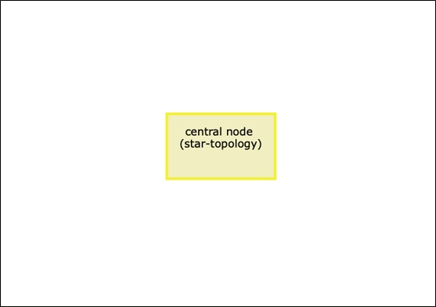
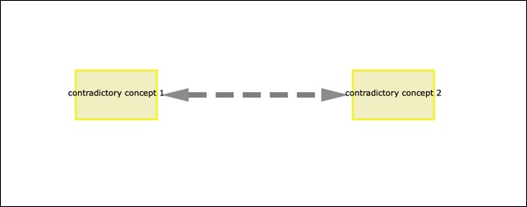
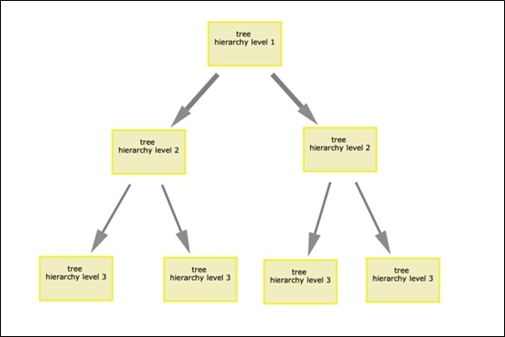
Network topologies Design CAM study
different sets of predefined concepts and connections are possible (network topologies):
Single concept in the middle: design likely evokes a network which is equivalent to a physical star topology, where all concepts are connected to a central concept; high local and global density
Two contradictory concepts: interesting way of analyzing the perception of opposite poles or concepts; sub-networks of the resulting CAMs can be analyzed and compared separately; high local densities and medium global density
Tree Topology: nudges participants towards “adding leaves to a predefined tree”: typically have low overall and local density
No predefined concepts: typically results in a partially connected mesh topologies

Slide 33
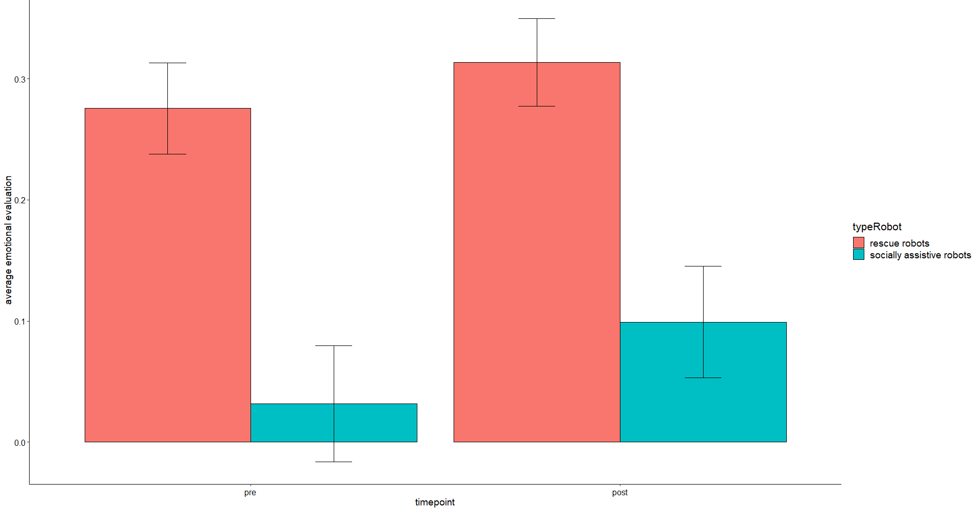
Intervention Design Example soft robot intervention
Study Design
search and rescue missions
Welcome and consent
Random assignment
Draw CAM
Add information on soft robots
Adjust drawn CAM
socially assistive
Results
Within: More positive assessment of soft robots compared to rigid robots in both case studies
Between: More positive assessment of search and rescue soft robots compared to socially assistive soft robots
Estadieu*, L., Fenn*, J., Gorki, M., Monno, I., Tauber, F., Teichmann, J., Levy-Tzedek, S., Müller, O., & Kiesel, A. (in prep.). Societal Assessment of Soft Robots: Identifying Key Risks and Benefits of Soft Robots Compared to Conventional Robots.

Slide 34
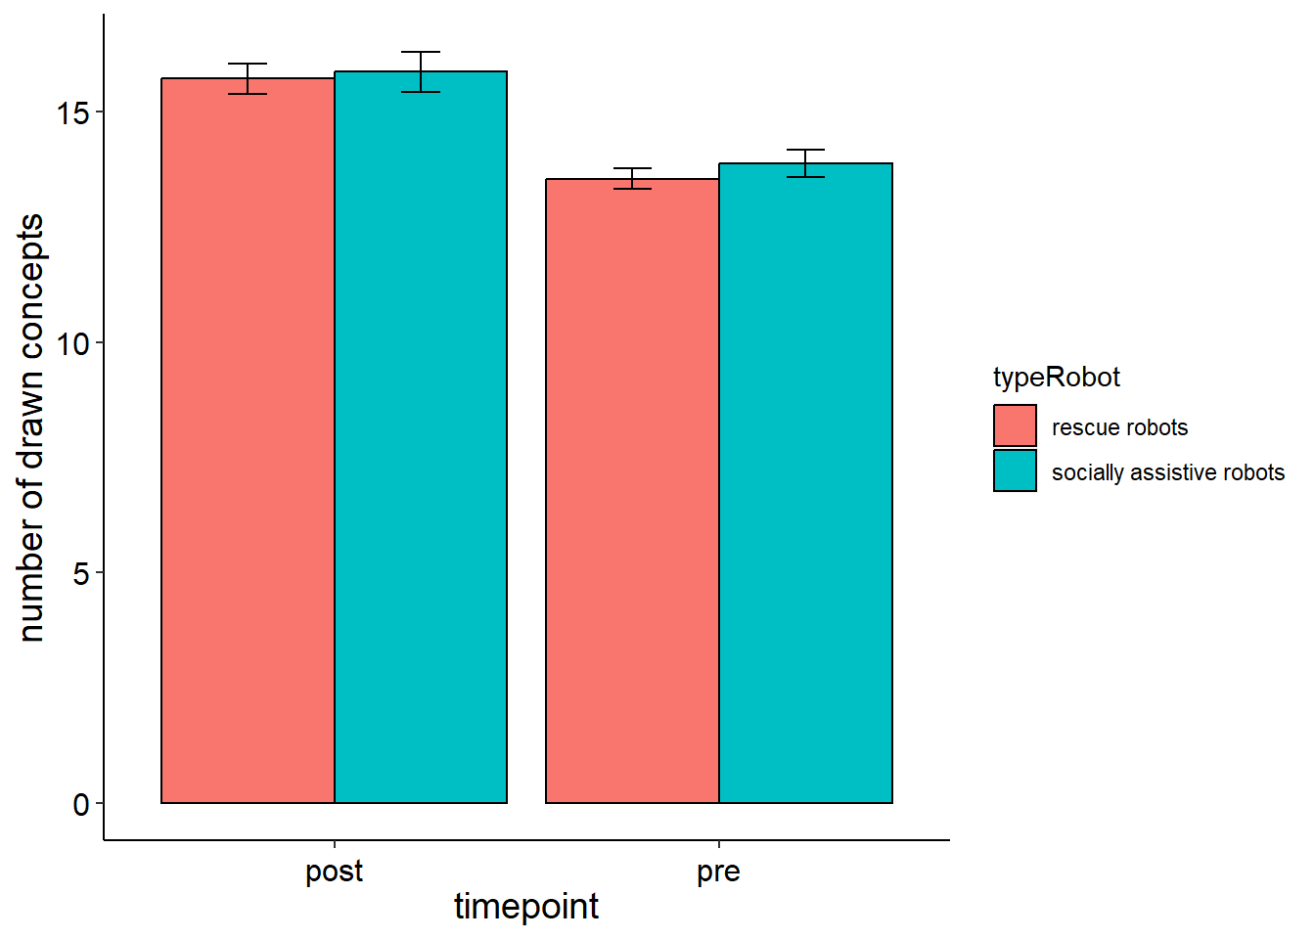
Intervention Design Delta CAMs – conceptual perspective
Typ A
Typ C
Results (N=224 CAMs)
A B C D
1 145 39 39
O
C₁
C₂
C₁
C₂
Typ B
Typ D
N
O
N
C₁
C₂
C₁
C₂
O = old, N = new, C = constant
(Reuter et al., 2021)
Estadieu*, L., Fenn*, J., Gorki, M., Monno, I., Tauber, F., Teichmann, J., Levy-Tzedek, S., Müller, O., & Kiesel, A. (in prep.). Societal Assessment of Soft Robots: Identifying Key Risks and Benefits of Soft Robots Compared to Conventional Robots.

Slide 35

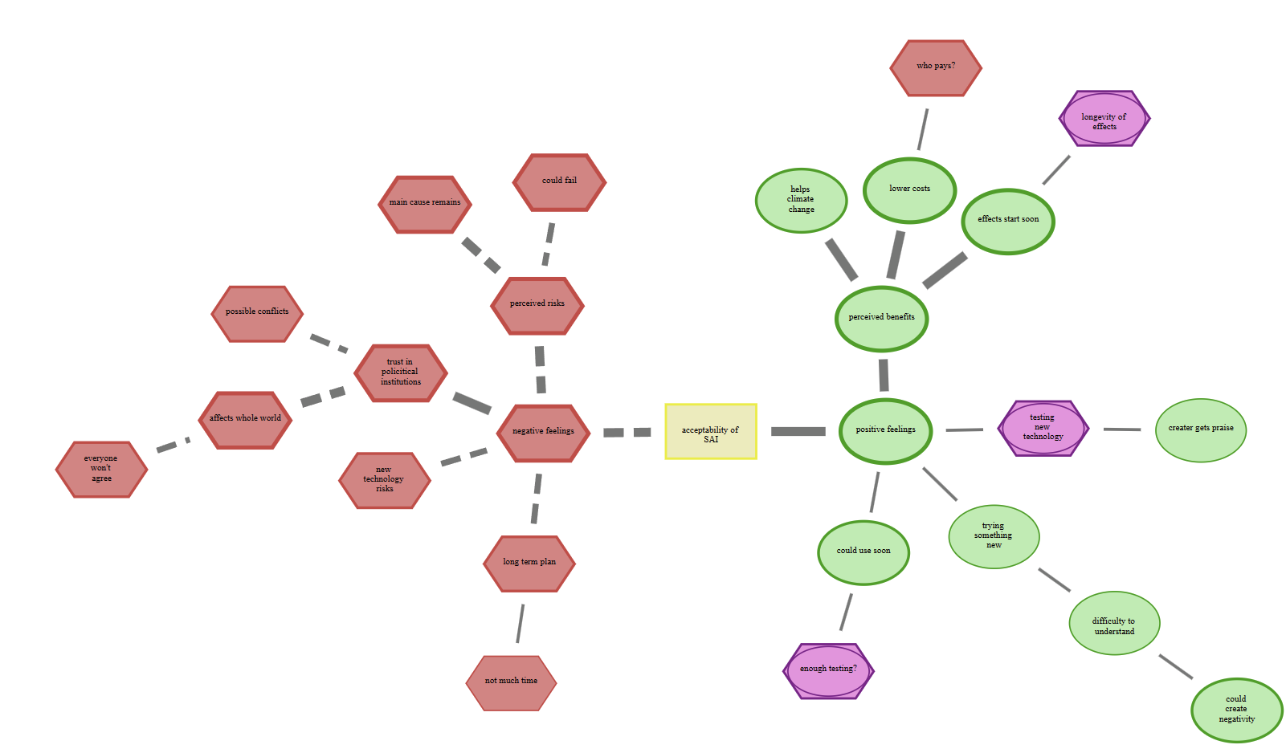
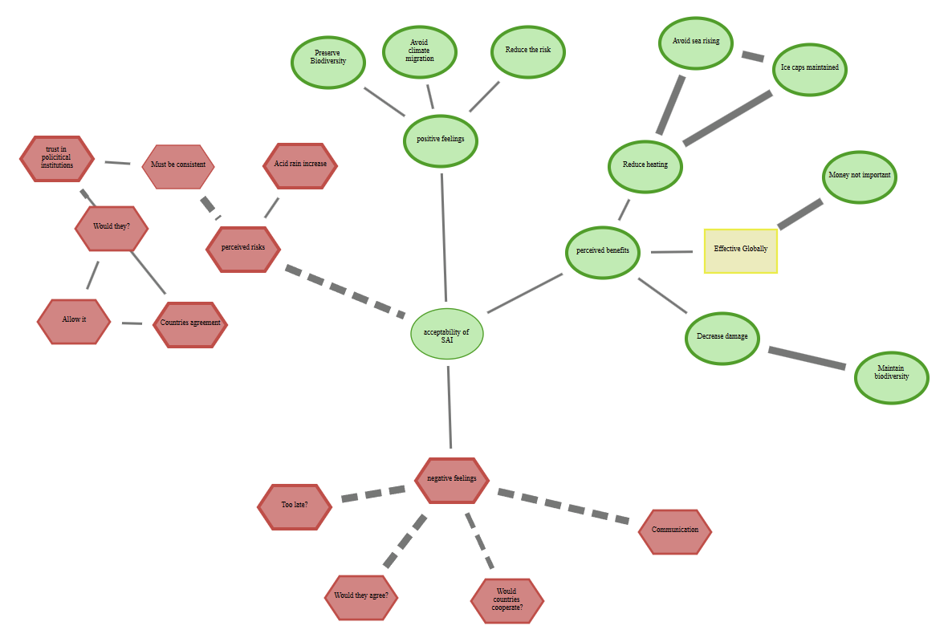
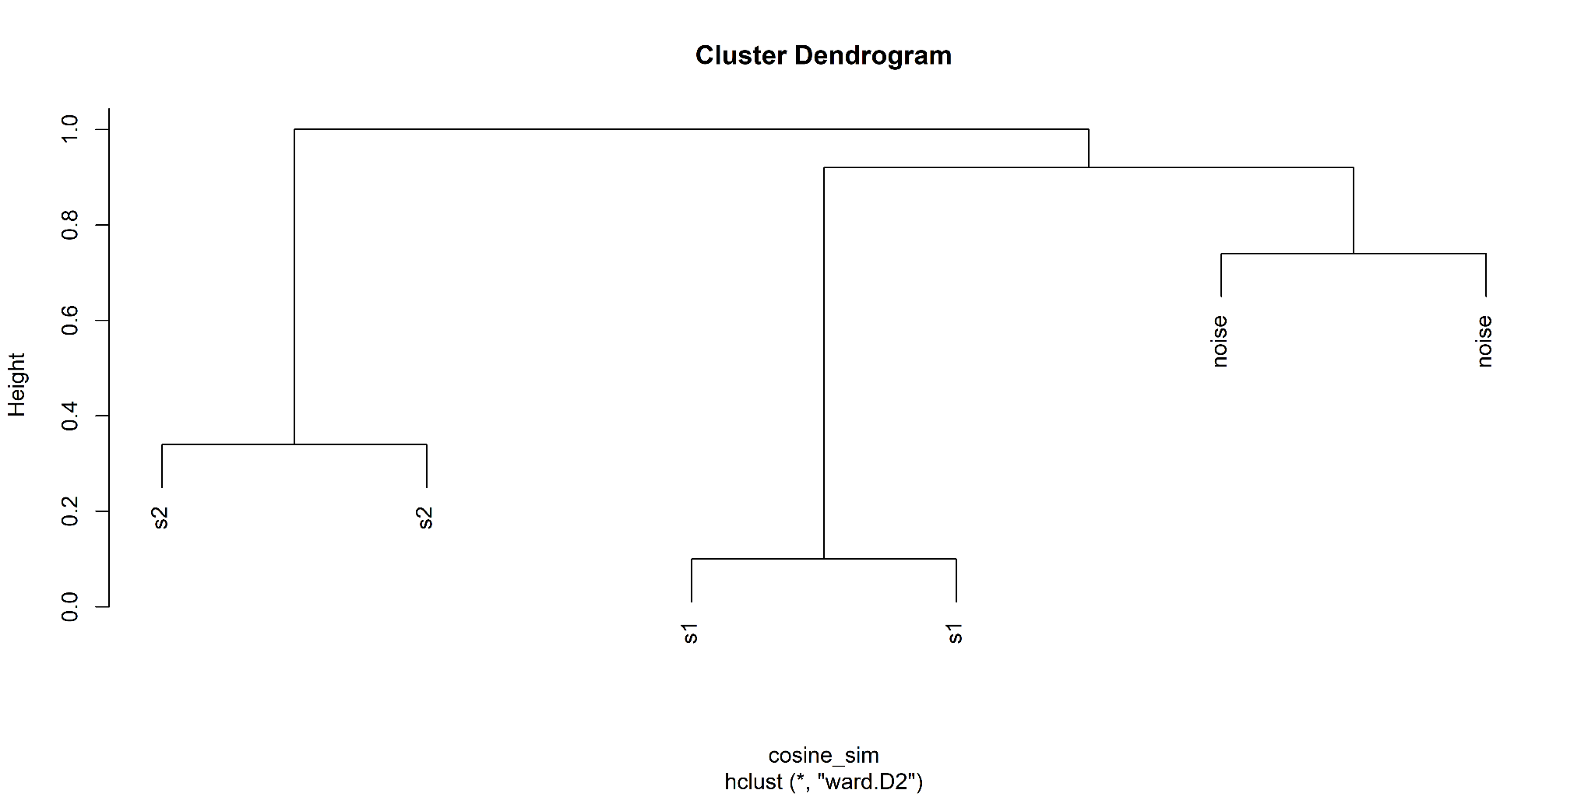
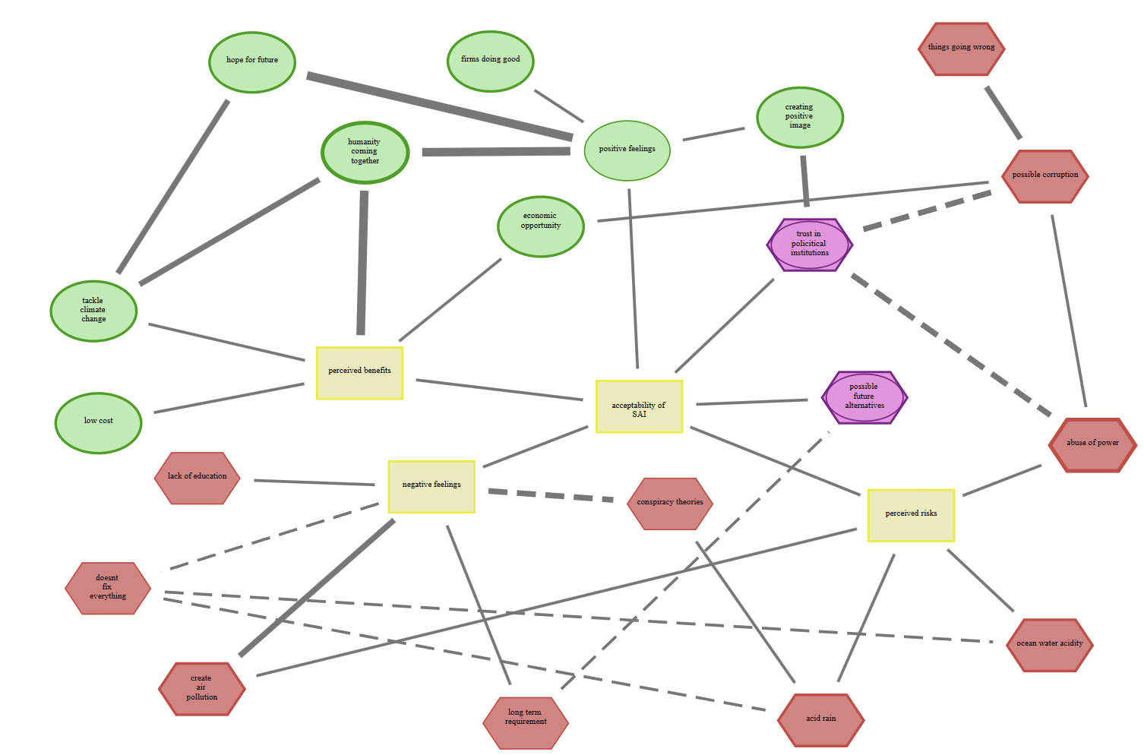
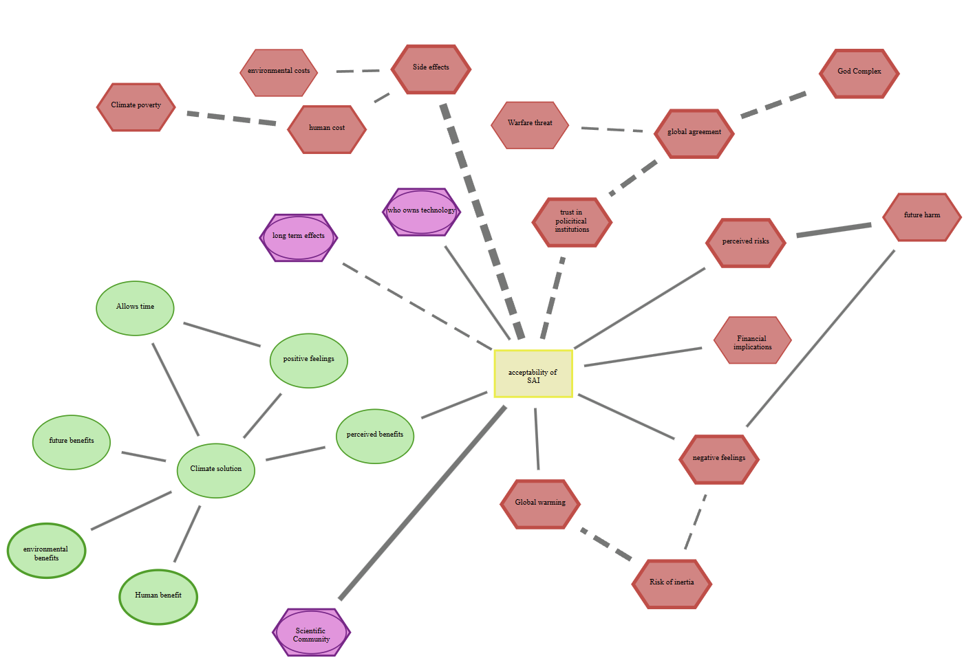
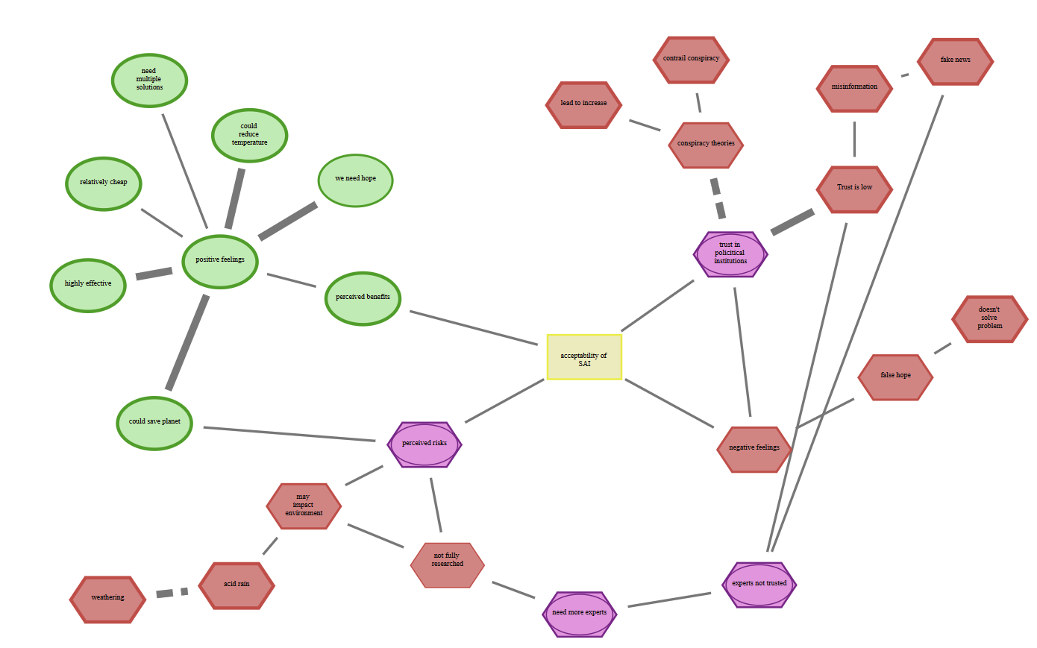
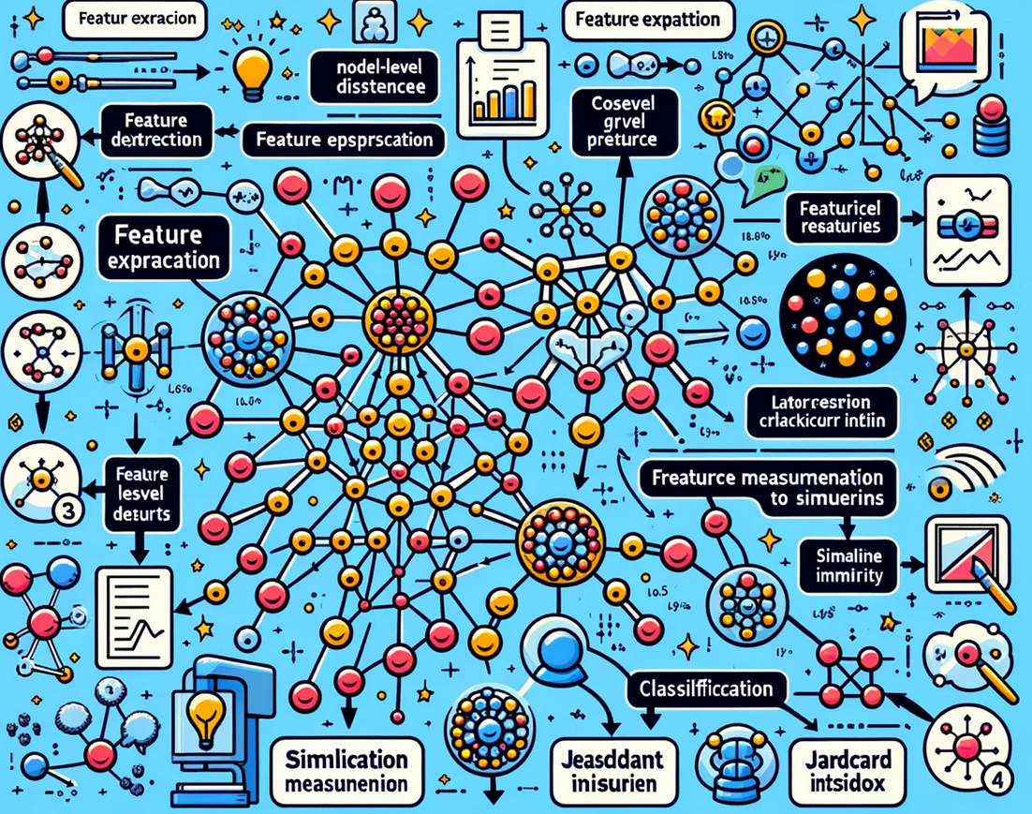
Boost analysis of CAMs Conceptual perspective
(a) applying large language models to automatically summarize data
followed by cluster analysis
to identify important sub-groups
large-scale CAM study
(b) applying network similarity algorithms
to automatically identify structures within CAM data
enables the identification of (a) central arguments / narratives and (b) latent network topologies regarding emerging technologies between groups of people

Slide 36
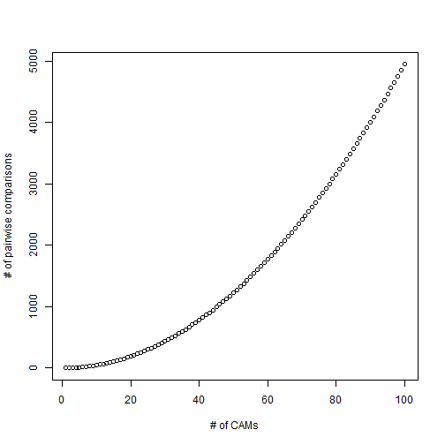
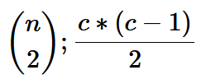
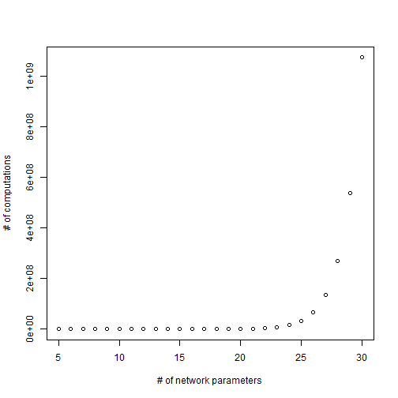
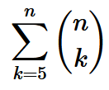
Boost analysis of CAMs Conceptual perspective on complexity
time complexity (TO) is the computational complexity that describes the amount of computer time it takes to run an algorithm
TO1: number of possible pairwise CAM comparisons determined by the binomial coefficient, whereby c is the number of CAMs to compare
TO2: number of network parameters determined by the sum over different binomial coefficients, whereby k is the number of parameters

Slide 37
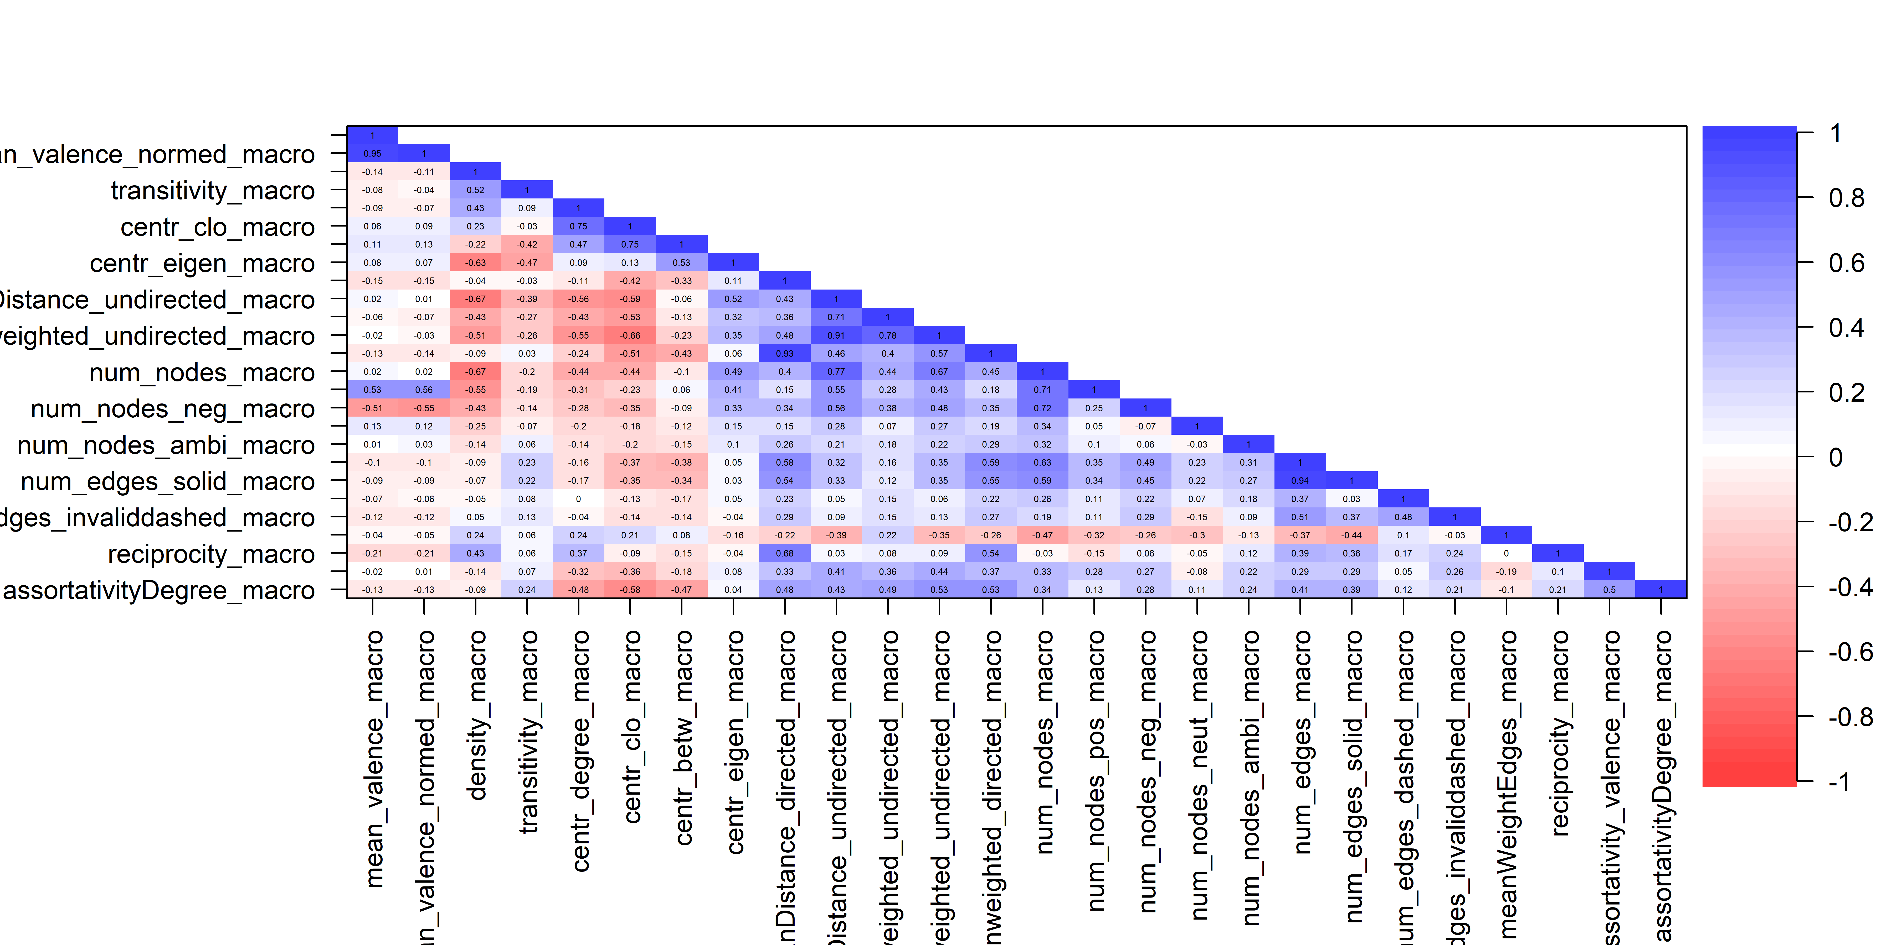
Boost analysis of CAMs reduce TO2
TO2: number of network parameters determined by the sum over different binomial coefficients, whereby k is the number of parameters
Network indicators are highly correlated, statistical artifacts

Slide 38
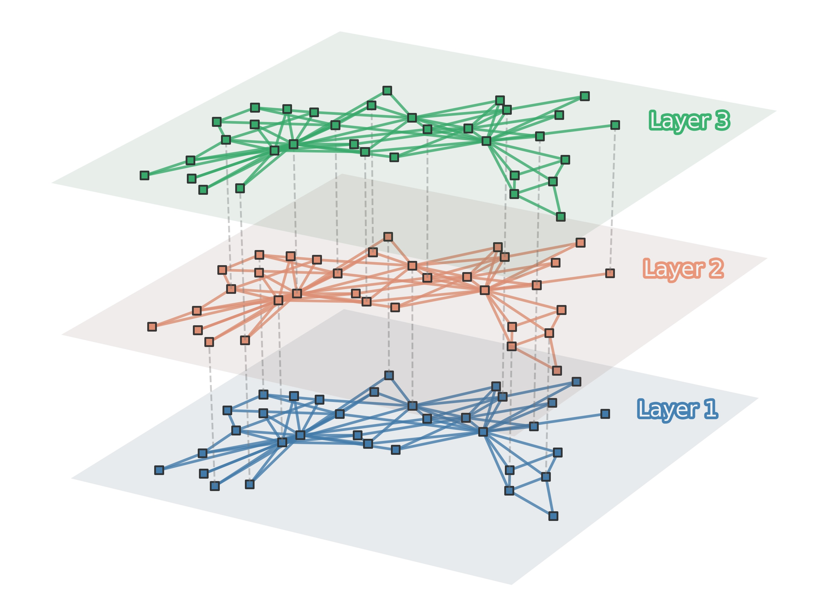
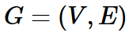
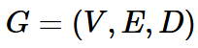
Boost analysis of CAMs Outcome – multilayer perspective
After (a) applying large language models or (b) applying network similarity algorithms
A CAM (graph) is in general defined by
Multilayer networks are defined by
, whereby D is a set of dimensions (or layers = CAMs)
Community Extraction in Multilayer Networks with Heterogeneous Community Structure (2017); https://jmlr.csail.mit.edu/papers/volume18/16-645/16-645.pdf
enables the identification of (a) central arguments / narratives
38

